Slide 1
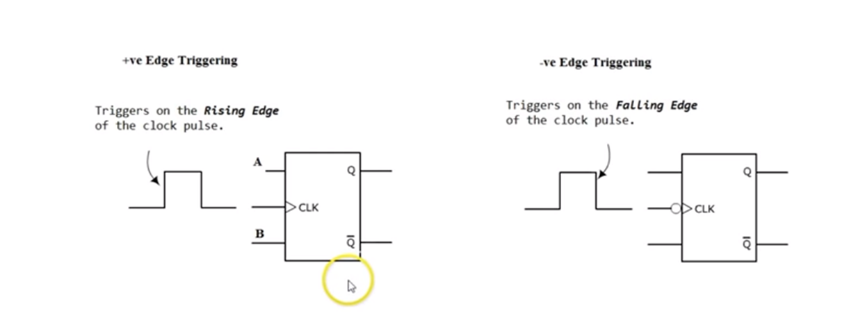
Lecture 7 Expounded
Positive and Negative Edge triggering

Slide 2
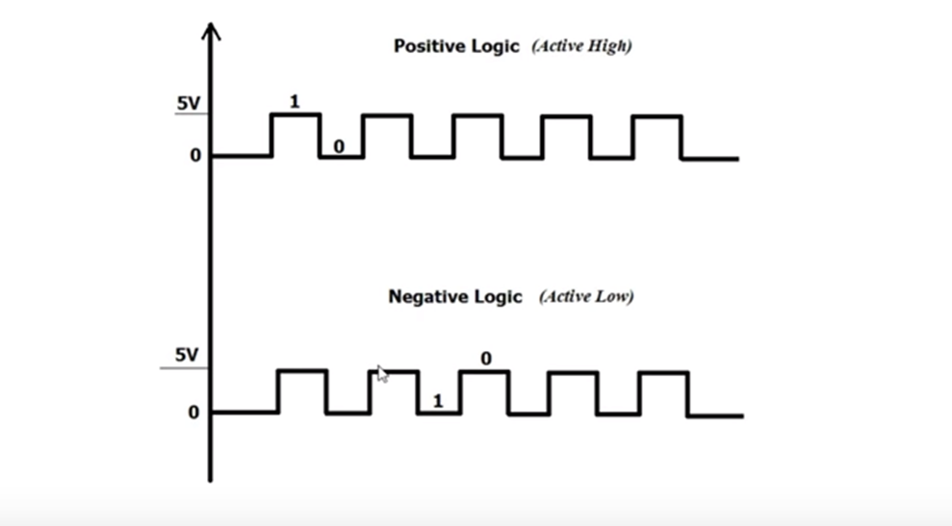
Positive and Negative Edge triggering

Slide 3
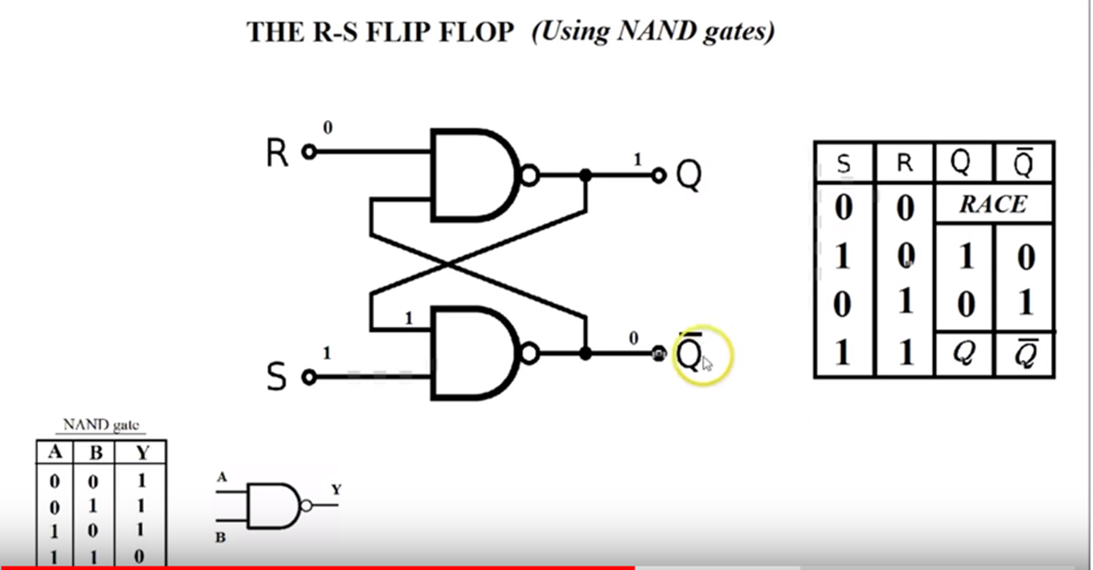
SR Flip flop

Slide 4
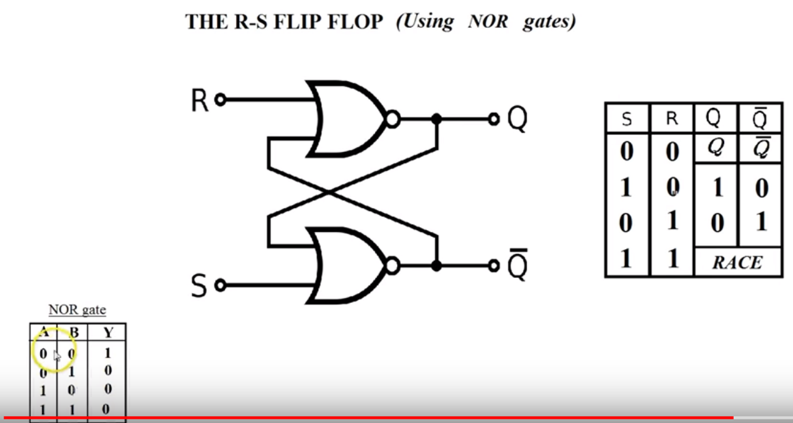
SR Flip flop

Slide 5
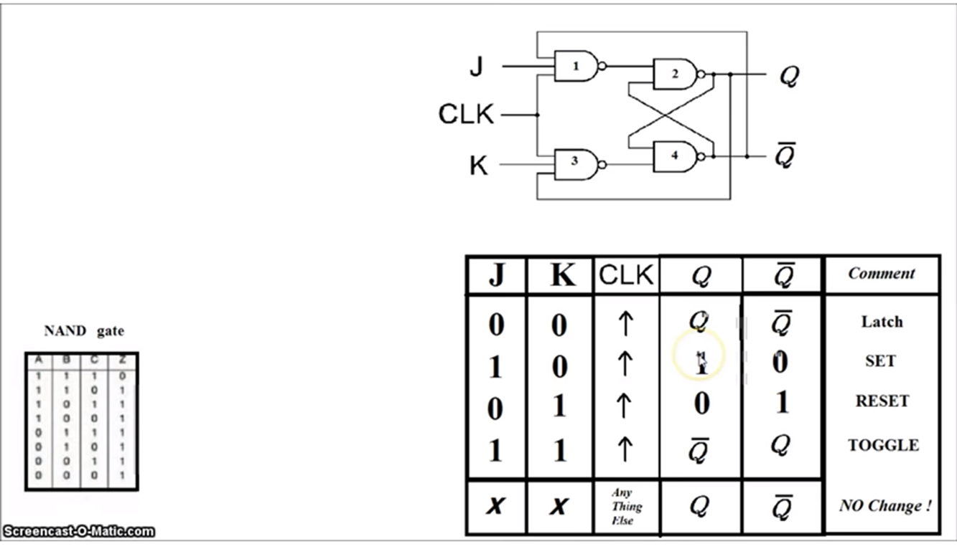
J K Flip Flop

Slide 6
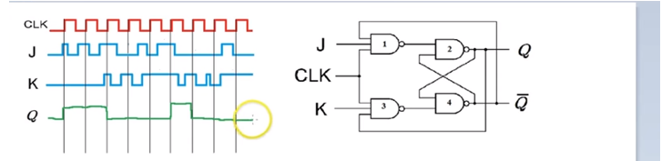
J K Flip Flop Timing diagram
Positive Edge triggering

Slide 7
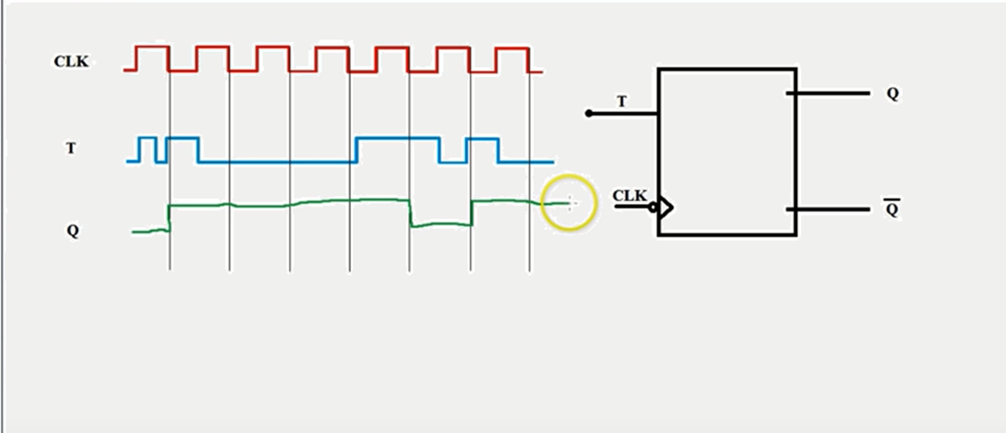
T flip flop Timing diagram
Negative Edge triggering

Slide 8
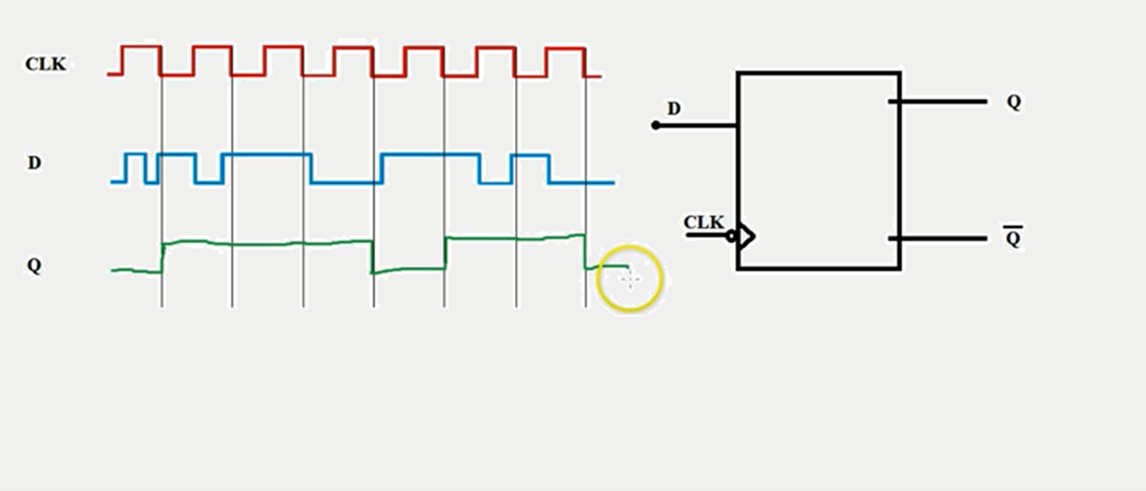
D Flip Flop Timing diagram
Negative Edge triggering

